Slide 1
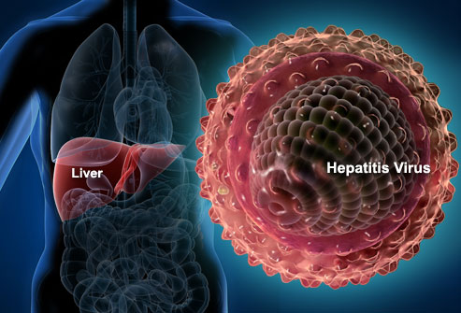
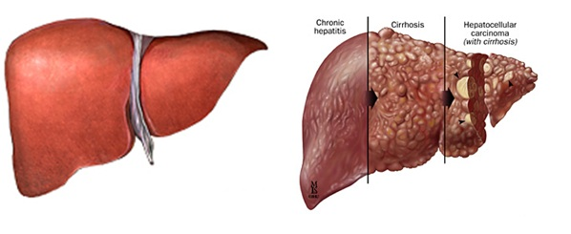
Hepatitis Viruses
Dr. CHHAY SOKDALIS

Slide 2
Objectives
Describe the morphology of hepatitis virus.
Remember the characteristic of hepatitis virus.
Illustrate the different stages of multiplication of hepatitis virus.
Explain how each type of hepatitis virus transmitted.
Identify the factors influencing the frequency of infection.
Describe the pathogenesis of hepatitis virus infection.
Interpret the different stages in the evolution of hepatitis virus infection.
Describe the clinical manifestations of hepatitis virus.
List the techniques for detecting hepatitis virus.
Describe the treatment of hepatitis virus.

Slide 3
Introduction
Hepatitis alphabet of viruses: at least 6 viruses, A-E, and G.
Target organ→liver.
Similar: basic hepatitis symptoms.
Differ greatly: structure, mode of replication, mode of transmission, and in time course and sequelae of disease they cause.
Hepatitis viruses→ infects and damages liver, causing classic icteric symptoms of jaundice and release of liver enzymes.
Virus spread: infected people are contagious before, or even without, showing symptoms.

Slide 4
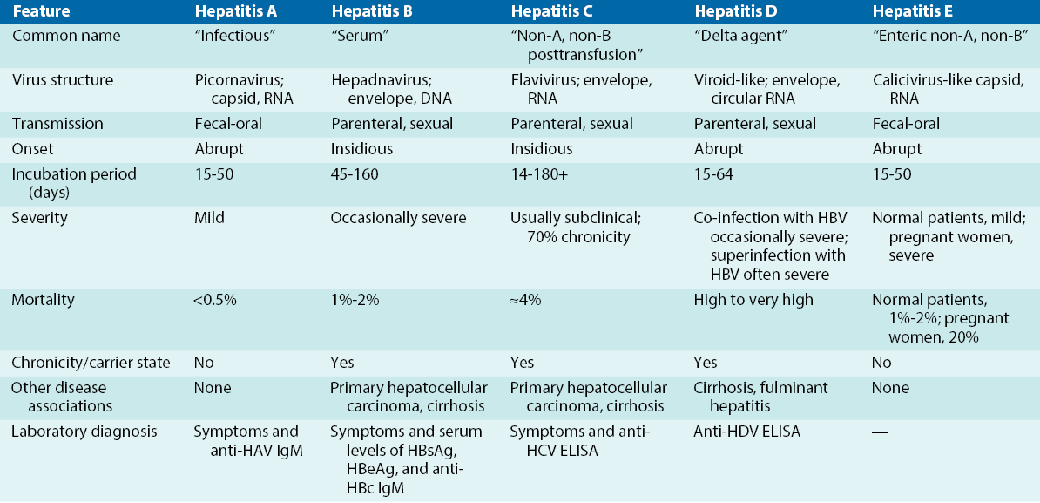
Comparative Features of Hepatitis Viruses

Slide 5
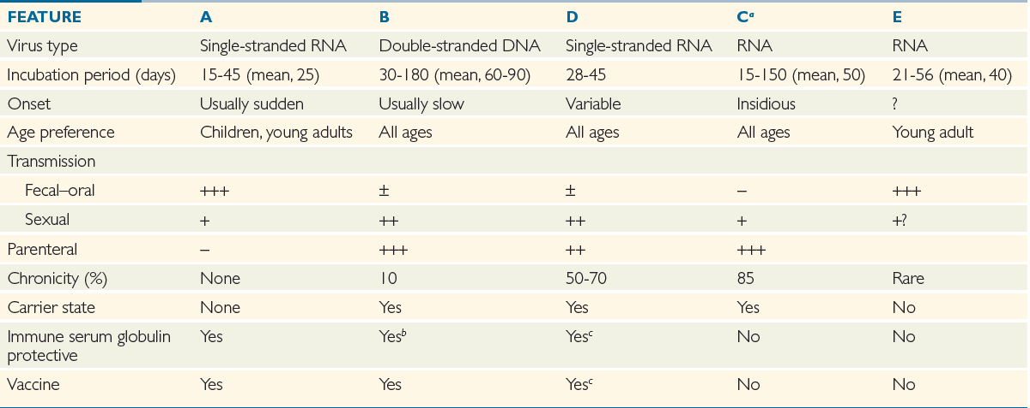
Comparative Features of Hepatitis Viruses

Slide 6
HEPATITIS A VIRUS

Slide 7
Introduction
Infectious hepatitis
Picornavirus: ribonucleic acid (RNA) virus; genus, Heparnavirus.
Transmission: fecal-oral route (consumption of contaminated water, shellfish, or other food).
Incubation period: 1 month, after which icteric symptoms start abruptly.
Rarely causes fatal disease.

Slide 8
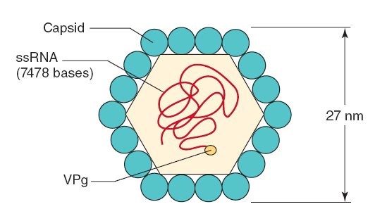
Structure
Capsid: 27nm, naked, icosahedral capsid
Genome: (+) sense, ss RNA genome (7470 nucleotides (VPg protein 5′ end and a polyadenylate sequence 3′ end)).
Only one serotype of HAV.
Capsid is even more stable than other picornaviruses:
Acid at pH 1
Solvents (ether, chloroform)
Detergents
Salt water,
Groundwater (months)
Drying (stable)
Stable at −20°C
Temperature:
4° C: weeks
56° C for 30 min: stable
61° C for 20 min: partial inactivation
Inactivated by:
Chlorine treatment of drinking water
Formalin (0.35%, 37° C, 72 h)
Peracetic acid (2%, 4 h)
β-Propiolactone (0.25%, 1 h)
Ultraviolet radiation (2μW/cm²/min)

Slide 9
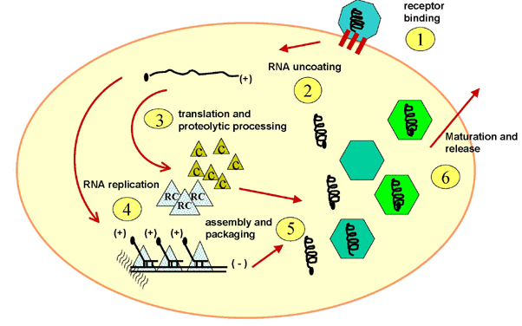
Replication
Receptor: (α2-macroglobulin) on target cells (liver cells and T cells).
Entry: receptor-mediated endocytosis (viropexis).
Unlike other picornaviruses, HAV is not cytolytic and is released by exocytosis.

Slide 10
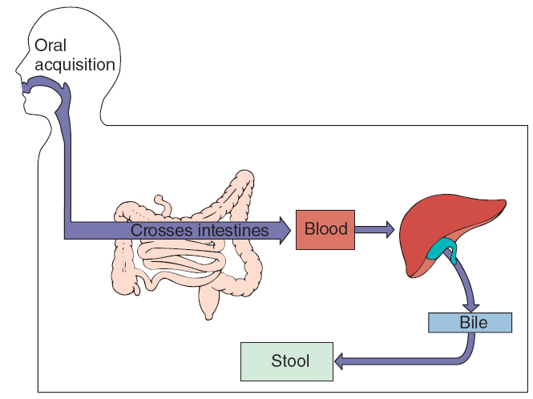
Pathogenesis

Slide 11
Pathogenesis and Immunity
HAV is ingested→bloodstream (epithelial lining of oropharynx or intestines→viremia→parenchymal cells of liver (released into bile→ stool).
Replicates in hepatocytes and Kupffer cells slowly without producing apparent cytopathic effects.
Shed: in large quantity into stool (10 days before symptoms of jaundice appear or Ab can be detected).
Interferon limits viral replication, natural killer cells and cytotoxic T cells→eliminate infected cells.
Ab, complement, and Ab-dependent cellular cytotoxicity facilitate clearance of virus→ immunopathology →Icterus.
Initial immune response IgM → IgG (few weeks)→ persist indefinitely in serum → immune to reinfection.
No chronic infection and hepatic cancer.

Slide 12
Epidemiology
Major natural hosts: Humans
Animal: primates (chimpanzees and marmosets)
40% of acute cases of hepatitis
90% of infected children and 25-50% of infected adults have inapparent but productive infections.
Spread: fecal–oral route, contaminated water, food, dirty hands and Shellfish (clams, oysters, and mussels).
Long incubation period: 15-40 days (mean 25 days).

Slide 13
Clinical Syndromes
Usually asymptomatic
Very similar to HBV
Disease: children < adults
Symptoms occur abruptly 15-50 days after exposure and intensify for 4-6 days before icteric (jaundice) phase.
Initial symptoms: fever, fatigue, nausea, loss of appetite, and abdominal pain. Dark urine, pale stool, and then jaundice may be accompanied by abdominal pain and itch.
Jaundice is observed in 70-80% of adults but in only 10% of children (<6 years of age).
99% →recovery, 0.1%→fulminant fatal hepatitis.

Slide 14
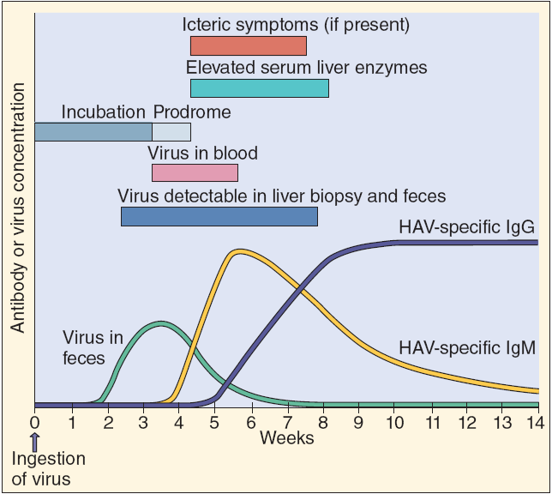
Clinical Syndromes

Slide 15
Laboratory Diagnosis
Specific serologic tests.
Acute HAV infection is by finding anti-HAV IgM, by ELISA or radioimmunoassay.
Convalescence→IgG

Slide 16
Treatment, Prevention, and Control
Supportive measures: nutrition and rest.
Reduced by interrupting fecal oral spread of virus→ avoid contaminated water or food, uncooked shellfish, proper hand washing (day-care centers, mental hospitals, and other care facilities).
Chlorine treatment of drinking water is sufficient to kill virus.
Prophylaxis with immune serum globulin given before or early in incubation period.
Vaccin: killed HAV vaccines (U.S) and live HAV vaccine (China).

Slide 17
HEPATITIS B VIRUS

Slide 18
Introduction
Hepatitis B: serum hepatitis.
Family: Hepadnaviridae (hepadnaviruses).
Infects liver and, to a lesser extent, kidneys and pancreas of only humans and chimpanzees.
Incubation period: 3 months, after which icteric symptoms start insidiously; is followed by chronic hepatitis in 5-10% of patients; is causally associated with primary hepatocellular carcinoma (PHC).
>1/3 of world’s population has been infected with HBV, resulting in 1-2 million deaths/year.

Slide 19
Structure
Genome: small, circular, partly dsDNA, 3200 bases.
Proteins:
Surface (envelope) protein (HBsAg),
Core (nucleocapsid) protein (HBcAg),
HBx protein (a transcriptional activator),
Associated with viral DNA: DNA polymerase (RNA-dependent DNA polymerase, DNA-dependent DNA polymerase, and RNase H activities (reverse transcriptase).
Another component of core (HBeAg).
Dane particle: 42nm in diameter.
Capsid: icosahedral enveloped with several unusual properties.
Envelope: 3 forms glycoprotein hepatitis B surface antigen (HBsAg) from pre-Golgi membranes.

Slide 20
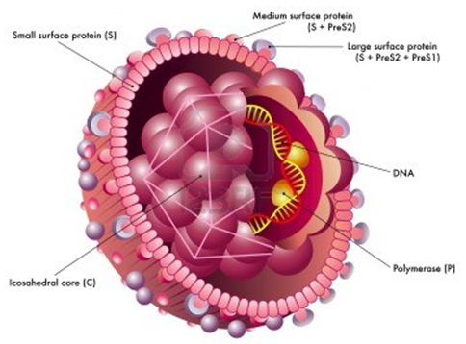
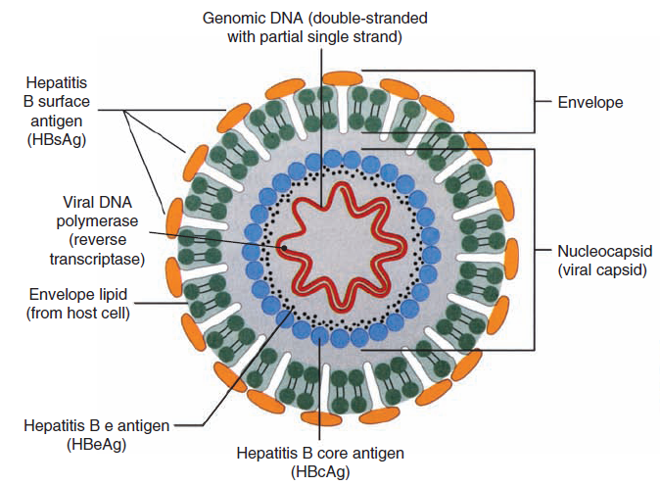
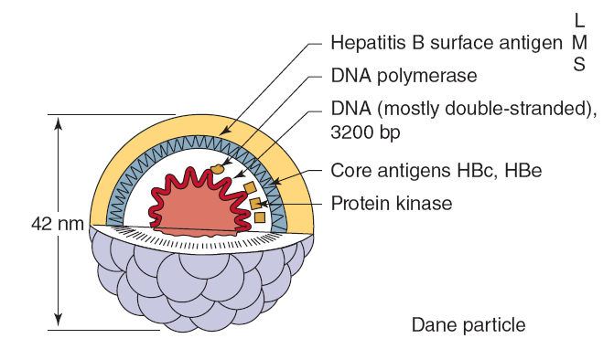
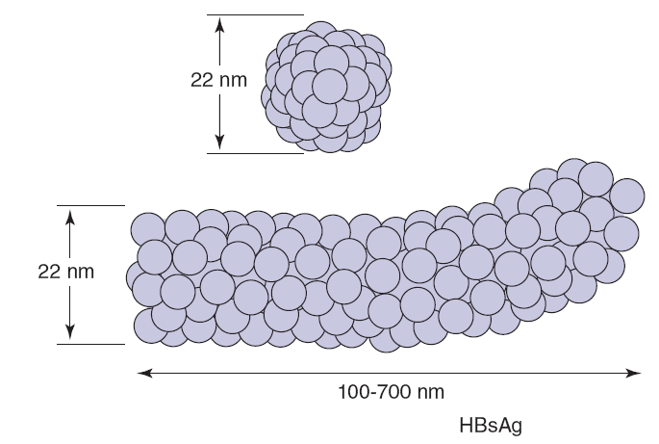
Structure

Slide 21
Replication
Specific tropism: liver
HBV genome can integrate into host chromosome.
HBV replicates through an RNA intermediate and produces and releases antigenic decoy particles (HBsAg).
Attachment: HBsAg glycoproteins→receptors (transferrin receptor, asialoglycoprotein receptor, and human liver annexin V).
Penetration: partial DNA strand→complete ds DNA circle→nucleus.
Virion→released from hepatocyte by exocytosis without killing cell, not by cell lysis.

Slide 22
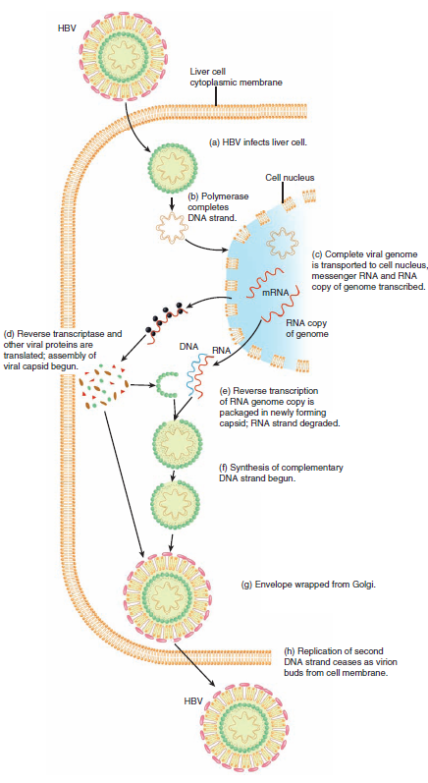
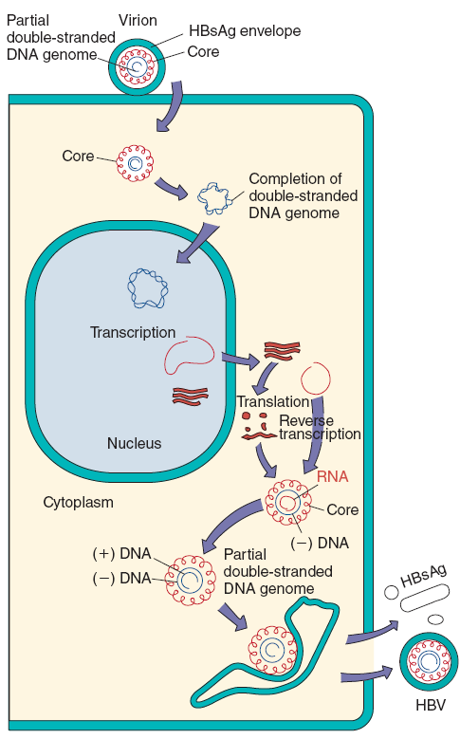

Slide 23
Pathogenesis and Immunity
Cause acute or chronic, symptomatic or asymptomatic disease.
Source of infectious virus: blood (major, injection), semen, saliva, milk, vaginal and menstrual secretions, and amniotic fluid.
Replicate: liver (minimal cytopathic effect) within 3 days of its acquisition, symptoms (≥45 days depending on infectious dose, route of infection, and person).
Symptom by Cell-mediated immunity and inflammation → resolution of HBV infection by eliminating infected hepatocyte.
Chronic hepatitis: insufficient T-cell response to infection→ mild symptoms→inability to resolve.
Chronic infection exhausts CD8 T cells preventing them from killing infected cells.

Slide 24
Pathogenesis and Immunity
Acute phase: liver parenchyma degenerative changes consisting of cellular swelling and necrosis, especially in hepatocytes surrounding central vein of a hepatic lobule.
Inflammatory cell infiltrate is mainly composed of lymphocytes.
Resolution of infection allows parenchyma to regenerate.
Fulminant infections: chronic infections, or co-infection+delta agent→permanent liver damage and cirrhosis.

Slide 25
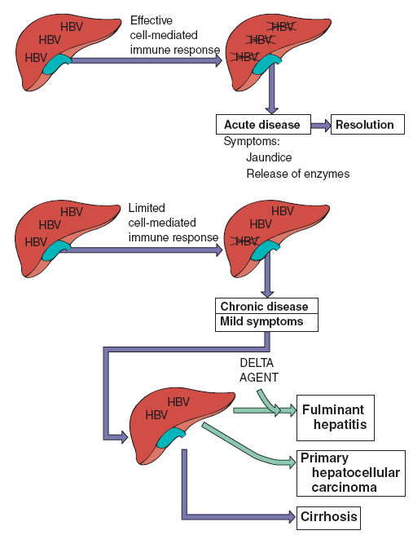
Pathogenesis

Slide 26
Epidemiology
World: 1/3 people have been infected with HBV→ a million deaths/year.
>350 million people→chronic HBV infection.
High rates of seropositivity: Italy, Greece, Africa, and Southeast Asia.
Many asymptomatic chronic carriers with virus in blood and other body secretions foster spread of virus.
Spread: sexual, parenteral, and perinatal routes.
Transmission: contaminated blood and blood components by transfusion, needle sharing, acupuncture, ear piercing, or tattooing, and through very close personal contact exchange of semen, saliva, and vaginal secretions (e.g., sex, childbirth).

Slide 27
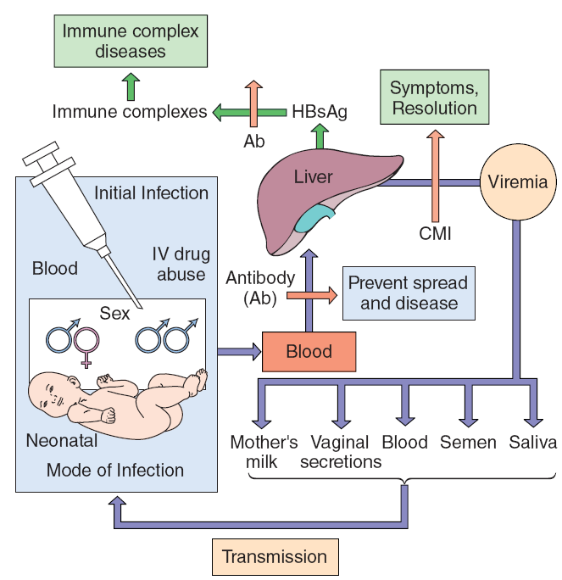
Epidemiology

Slide 28
Epidemiology
High-Risk Groups for Hepatitis B Virus Infection
People from endemic regions (i.e., China, parts of Africa, Alaska, Pacific Islands)
Babies of mothers with chronic hepatitis B virus
Intravenous drug abusers
People with multiple sex partners, homosexual and heterosexual
Hemophiliacs and other patients requiring blood and blood product treatments
Health care personnel who have contact with blood
Residents and staff members of institutions for mentally retarded
Hemodialysis patients and blood and organ recipients.

Slide 29
Clinical Syndromes
Acute Infection
Long incubation period and an insidious onset.
Prodrome: fever, malaise, and anorexia, followed by nausea, vomiting, abdominal discomfort, and chills.
Icteric symptoms of liver damage (e.g., jaundice, dark urine, pale stools).
Fulminant hepatitis (1%)→liver damage: ascites and bleeding.
Hypersensitivity reactions: rash, polyarthritis, fever, acute necrotizing vasculitis, and glomerulonephritis.

Slide 30
Clinical Syndromes
Chronic Infection
5-10% of people with HBV infections
2/3→chronic passive hepatitis→less problems.
1/3→chronic active hepatitis→destruction of liver →scarring of liver, cirrhosis, liver failure, or PHC.
HBV→PHC promoting continued liver repair and cell growth in response to inflammation and tissue damage or by integrating into host chromosome and stimulating cell growth directly.
HBV genome→mutation→carcinogenesis.
Latency period between HBV infection and PHC may be as short as 9 years or as long as 35 years.

Slide 31
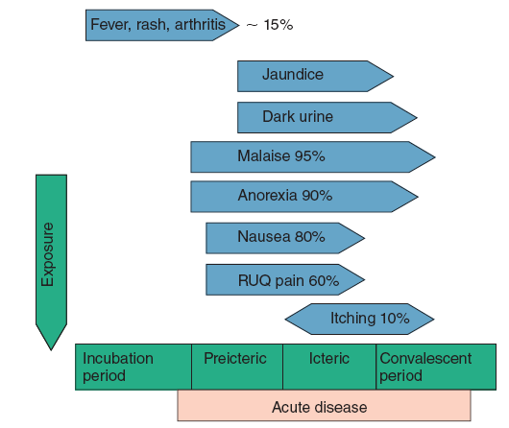
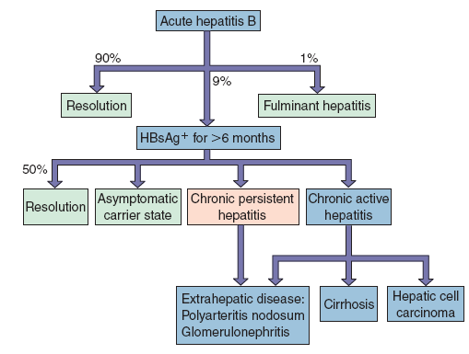
Clinical Syndromes

Slide 32
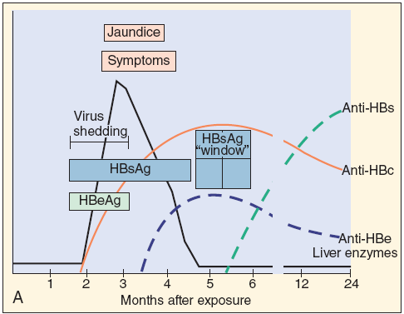
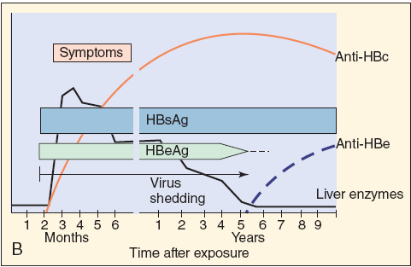
Clinical Syndromes

Slide 33
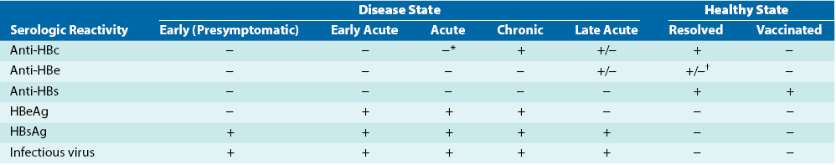
Laboratory Diagnosis
Initial diagnosis: clinical symptoms and presence of liver enzymes in blood.
Serology: course and nature of disease
HBsAg and HBeAg→blood during viral replication.
Anti-HBs→resolution of infection or vaccination.
Anti-HBc→current or prior infection.
PCR: amount of virus in blood.

Slide 34
Laboratory Diagnosis

Slide 35
Treatment, Prevention, and Control
Chronic HBV infection can be treated with drugs targeted at polymerase (lamivudine) or nucleoside analogues (adefovir dipivoxil and famciclovir) for 1 year.
Pegylated interferon-α can also be effective and is taken for at least 4 months.
Prevention:
Systematic screening of donor blood
Hygienic measure
Vaccination of population at risk or high-risk profession: doctor, nurse, lab technician ....
Limit sexual partner

Slide 36
HEPATITIS C VIRUSES

Slide 37
Introduction
HCV→NANBH virus infections and major cause of post transfusion hepatitis before routine screening of blood supply for HCV.
>170 million carriers of HCV in world and >4 million in US.
HCV is transmitted by similar to HBV but has an even greater potential for establishing persistent, chronic hepatitis.
Chronic hepatitis→cirrhosis and hepatocellular carcinoma.
Incubation period: 6-12 weeks.

Slide 38
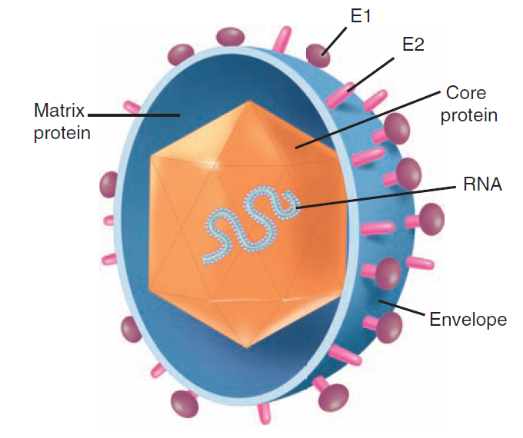
Structure
Genus: Hepacivirus
Family: Flaviviridae
Diameter: 30-60 nm
Genome: a positive-sense ssRNA (9100 nucleotides encodes 10 proteins, 2 glycoproteins (E1, E2)) and enveloped.
Icosahedral capsid

Slide 39
Replication
HCV infects only humans and chimpanzees.
Receptor: CD81 (tetraspanin) on hepatocytes and B lymphocytes, and coat LDL or VLDL (use lipoprotein receptor→hepatocytes).
Replicates like other flaviviruses.
Entry: Receptor-mediated endocytosis.
Uncoating: Fusion of virus membrane with endosomal
Virion assembles and buds into endoplasmic reticulum.
HCV proteins inhibit apoptosis and interferon-α action by binding to tumor necrosis factor receptor and protein kinase R→prevent death of host cell→ persistent infection.

Slide 40
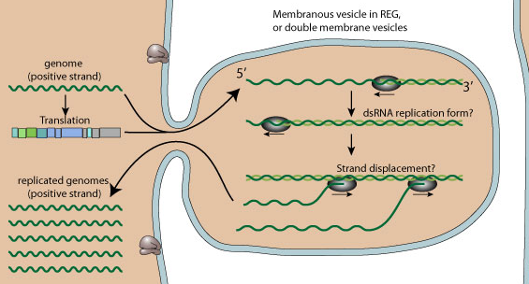
Replication
Replication / Translation
Place of replication/translation: surface of endoplasmic reticulum.
(+) RNA = mRNA → translation directly → single precursor polyprotein → viral proteins functional by viral protease.
dsRNA genome is transcribed / providing replicated viral mRNAs / new ssRNA (+) genome.
ssRNA (+) → dsRNA → (+) RNA genome.

Slide 41
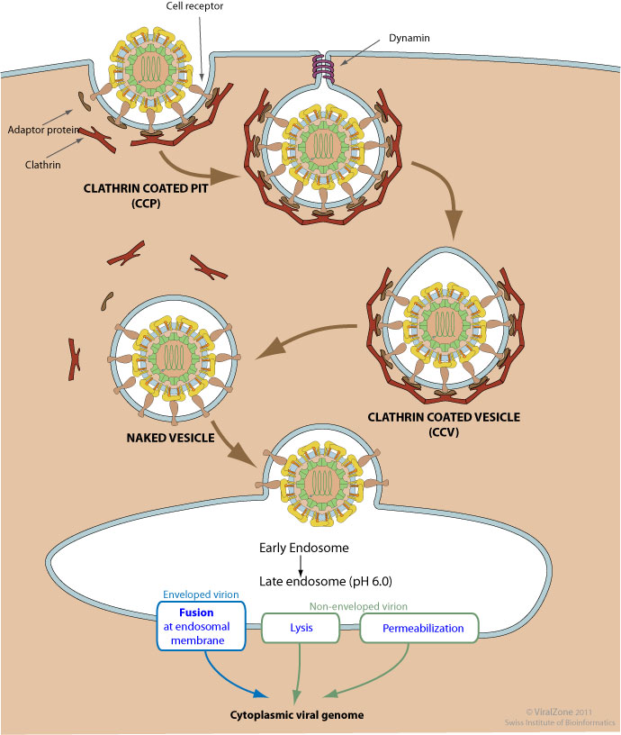
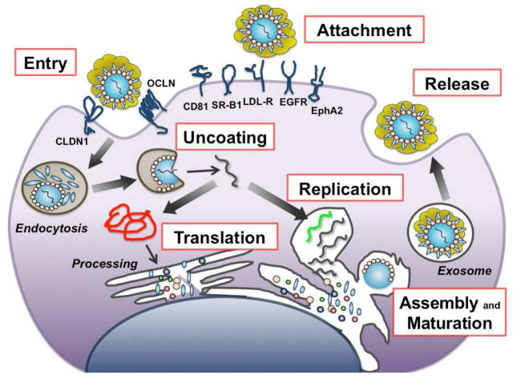
Replication

Slide 42
Pathogenesis and Immunity
Invades and infects peripheral blood B and T lymphocytes and monocytes→liver.
HCV→prevent host cell death→persistent infection→liver disease.
Cell-mediated immune responses: resolution of infection and tissue damage.
As for HBV, chronic infection can exhaust CD8 cytotoxic T cells to prevent resolution of infection.
Severity of disease: inflammation, portal and periportal fibrosis, and lobular necrosis in liver.
Cytokines of inflammation and continual liver repair and induction of cell growth during chronic HCV infection→ PHC.
Antibody to HCV is not protective.

Slide 43
Epidemiology
Transmission: blood and sexual.
Highest risk: Intravenous drug abusers, tattoo recipients, transfusion and organ recipients, and hemophiliacs receiving factors VIII or IX.
Prevalent: southern Italy, Spain, central Europe, Japan, and parts of Middle East
150 million chronically infected with HCV and 3-4 million people are infected every year.
350 000 people die with HCV-related liver disease every year.

Slide 44
Clinical Syndromes
Causes 3 types of disease:
acute hepatitis with resolution of infection and recovery in 15% of cases.
chronic persistent 70% of infected persons.
severe rapid progression to cirrhosis 15%.
Acute form: similar HAV and HBV, but inflammatory response is less intense, and symptoms usually milder.
>70% of cases initial disease is asymptomatic but establishes chronic persistent disease.

Slide 45
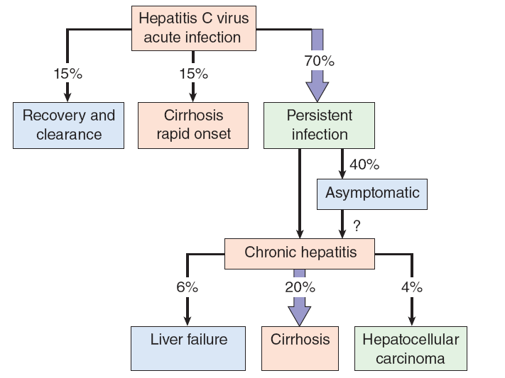
Clinical Syndromes

Slide 46
Clinical Syndromes
Predominant symptom: chronic fatigue.
Chronic, persistent disease→chronic active hepatitis 10-15 years→cirrhosis and liver failure after 20 years.
HCV-induced liver damage may be exacerbated by alcohol, certain medications, and other hepatitis viruses→cirrhosis.
HCV promotes development of hepatocellular carcinoma after 30 years in up to 5% of chronically infected patients.

Slide 47
Laboratory Diagnosis
ELISA (anti-HCV antibody): seroconversion occurs within 7-31 weeks of infection and confirmed by Western immunoblot procedures.
Quantitation RT-PCR: Detection RNA genome.

Slide 48
Treatment, Prevention, and Control
Treatment: recombinant interferon-α or pegylated interferon alone or with ribavirin (polymerase inhibitors: yield up to 50% recovery rates) + 2 protease inhibitors (boceprevir or telaprevir).
Precautions for transmission: similar HBV
Alcohol drinking should be limited because it exacerbates liver damage caused by HCV.

Slide 49
HEPATITIS G VIRUS

Slide 50
HEPATITIS G VIRUS
GB virus-C (GBV-C) resembles HCV in many ways.
(+) sense RNA virus 9.3 kb
HGV is a flavivirus, is transmitted in blood and has a predilection for chronic hepatitis infection.
Incubation period: 14-20 days.
Identify by detection of genome by RT-PCR or other RNA detection methods.

Slide 51
HEPATITIS D VIRUS

Slide 52
Introduction
15 million people in world infected with HDV (delta agent), →40% of fulminant hepatitis infections.
HDV is unique in that it uses HBV and target cell proteins to replicate and produce its one protein.
Viral parasite, proving that “even fleas have fleas.”
HBsAg is essential for packaging virus.
Delta agent resembles plant virus satellite agents and viroids in its size, genomic structure, and requirement for a helper virus for replication.

Slide 53
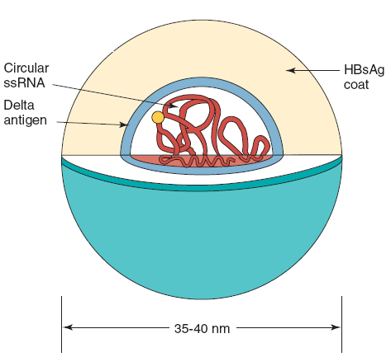
Structure and Replication
Genome: very small (1700 nucleotides), (-) ssRNA circular→ rod shape (extensive base pairing)→HDV capsid Ag.
Virion is same size as HBV virion (35-37nm in diameter).
Genome is surrounded by delta Ag core, which in turn is surrounded by an HBsAg containing envelope.
Delta Ag: small (24kDa) or large (27kDa) form; small form is predominant.

Slide 54
Structure and Replication
Attachment: hepatocytes in same as HBV (HBsAg in its envelope).
Transcription and replication processes of HDV genome are unusual.
Host cell’s RNA polymerase II makes an RNA copy to replicate genome→forms an RNA structure (ribozyme) cleaves RNA circle→mRNA for small delta Ag.
Gene for delta Ag is mutated by a cellular enzyme (dsRNA-activated adenosine deaminase) during infection→production of large delta Ag→limits replication virus but also promotes association of genome with HBsAg to form a virion→released from cell.

Slide 55
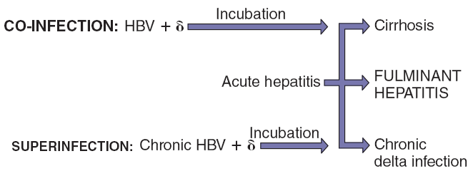
Pathogenesis
Spread in blood, semen, and vaginal secretions.
Replicate and cause disease only in people with active HBV infections.
Same routes→co-infected with HBV and HDV.
Chronic HBV→superinfected with delta agent.
Severe progression occurs in HBV carriers superinfected with HDV than in people co-infected with HBV and delta agent.

Slide 56
Pathogenesis
Replication→cytotoxicity and liver damage.
Ab are elicited against delta agent, protection probably stems from immune response to HBsAg because it is external Ag and viral attachment protein for HDV.
Unlike HBV disease, damage to liver occurs as a result of direct cytopathic effect of delta agent combined with underlying immunopathology of HBV disease.

Slide 57
Clinical Syndromes
Increases severity of HBV infections.
Fulminant hepatitis
Severe form of hepatitis→altered brain function (hepatic encephalopathy), extensive jaundice, and massive hepatic necrosis→ fatal 80% of cases.
Chronic infection: occur in people with chronic HBV.

Slide 58
Laboratory Diagnosis
Detecting RNA genome, or anti-HDV Ab.
ELISA and radioimmunoassay procedures are available for detection.
Detected in blood during acute phase of disease in a detergent-treated serum sample.
RT-PCR techniques can be used to detect virion genome in blood.

Slide 59
Treatment, Prevention, and Control
No known specific treatment for HDV hepatitis.
Prevention: prevent infection with HBV→prevents HDV infection and intravenous drug use and avoiding HDV-contaminated blood products.
Immunization with HBV vaccine protects against subsequent delta virus infection.

Slide 60
HEPATITIS E VIRUS

Slide 61
HEPATITIS E VIRUS
HEV (E-NANBH) is predominantly spread by fecal-oral route, especially in contaminated water.
Genus Hepevirus, Hepeviridae family.
HEV is unique but resembles caliciviruses, based on its size (27-34nm) and structure.
ssRNA (+), naked virus and icosahedral symmetry.
Most problematic in developing countries.
Epidemics: India, Pakistan, Nepal, Burma, North Africa, and Mexico.
Symptoms and course similar HAV disease.
Only acute disease.
Symptoms later than HAV disease.
Mortality rate 1-2%, approximately 10 times that associated with HAV disease.
HEV infection is especially serious in pregnant women (mortality rate 20%).

Slide 62
Reference
Patrick R. Murray, Ken S. Rosenthal, Michael A. Pfaller. MEDICAL MICROBIOLOGY. 2013. 7th EDITION.
Kenneth J. Ryan, MD, C. George Ray. Sherris Medical Microbiology. 6th edition. 2014.
Stefan Riedel, Stephen Morse, Timothy Mietzner, Steve Miller. Jawetz, Melnick & Adelberg’s Medical Microbiology-McGraw-Hill. 2019.

